Slide 1
English
Unit 1 – My World
WALT: Plan, write, edit and proofread short texts, with little or no support.

Slide 2



WALT: Plan, write, edit and proofread short texts, with little or no support.
I can plan an explanation text on an inspirational person.
I can use a range of connectives in my plan.
I can use research to inform my plan.

Slide 3
Retrieval Practice – List as many connectives as you can in 1 minute.
WALT: Plan, write, edit and proofread short texts, with little or no support.

Slide 4

WALT: Plan, write, edit and proofread short texts, with little or no support.

Slide 5
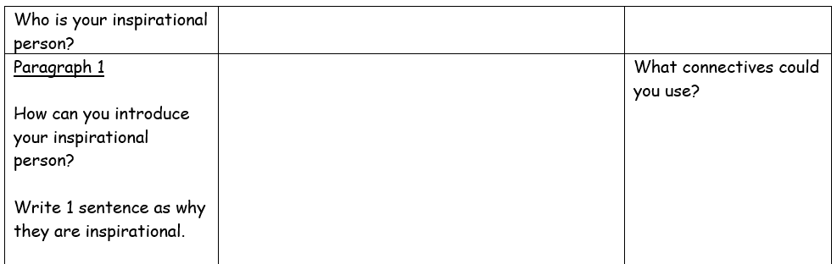
WALT: Plan, write, edit and proofread short texts, with little or no support.

Slide 6
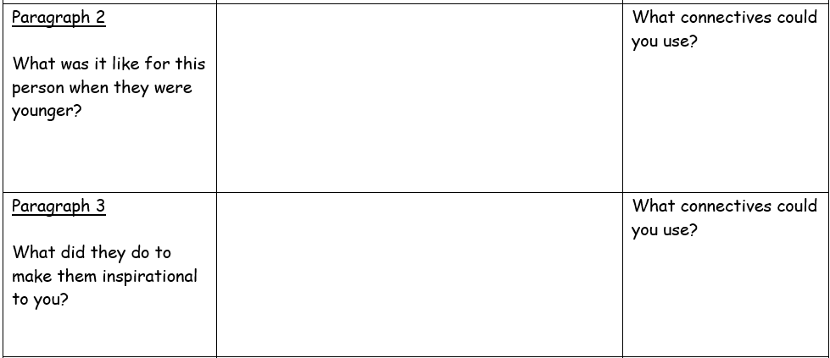
WALT: Plan, write, edit and proofread short texts, with little or no support.

Slide 7
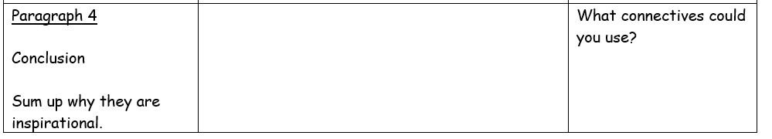
WALT: Plan, write, edit and proofread short texts, with little or no support.

Slide 8
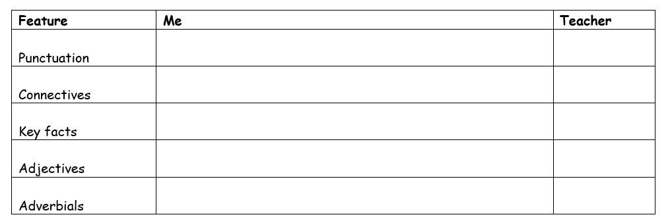
Next lesson, you will write your explanation piece on your inspirational person.
WALT: Plan, write, edit and proofread short texts, with little or no support.
This is what you’ll need to include in your writing.

Slide 9
WALT: Plan, write, edit and proofread short texts, with little or no support.
I can plan an explanation text on an inspirational person.
I can use a range of connectives in my plan.
I can use research to inform my plan.

